Slide 1
Migros Stores Challenge
Constructor Academy - Data Science - January 2025
Marisa Davis & Natalia Neamtu

Slide 2
Challenge presentation
Analysis of market opportunities based on
the density of existing stores
the presence of competitors
the general population density
local GDP
Finding the best places to create new Migros stores in Switzerland.

Slide 3
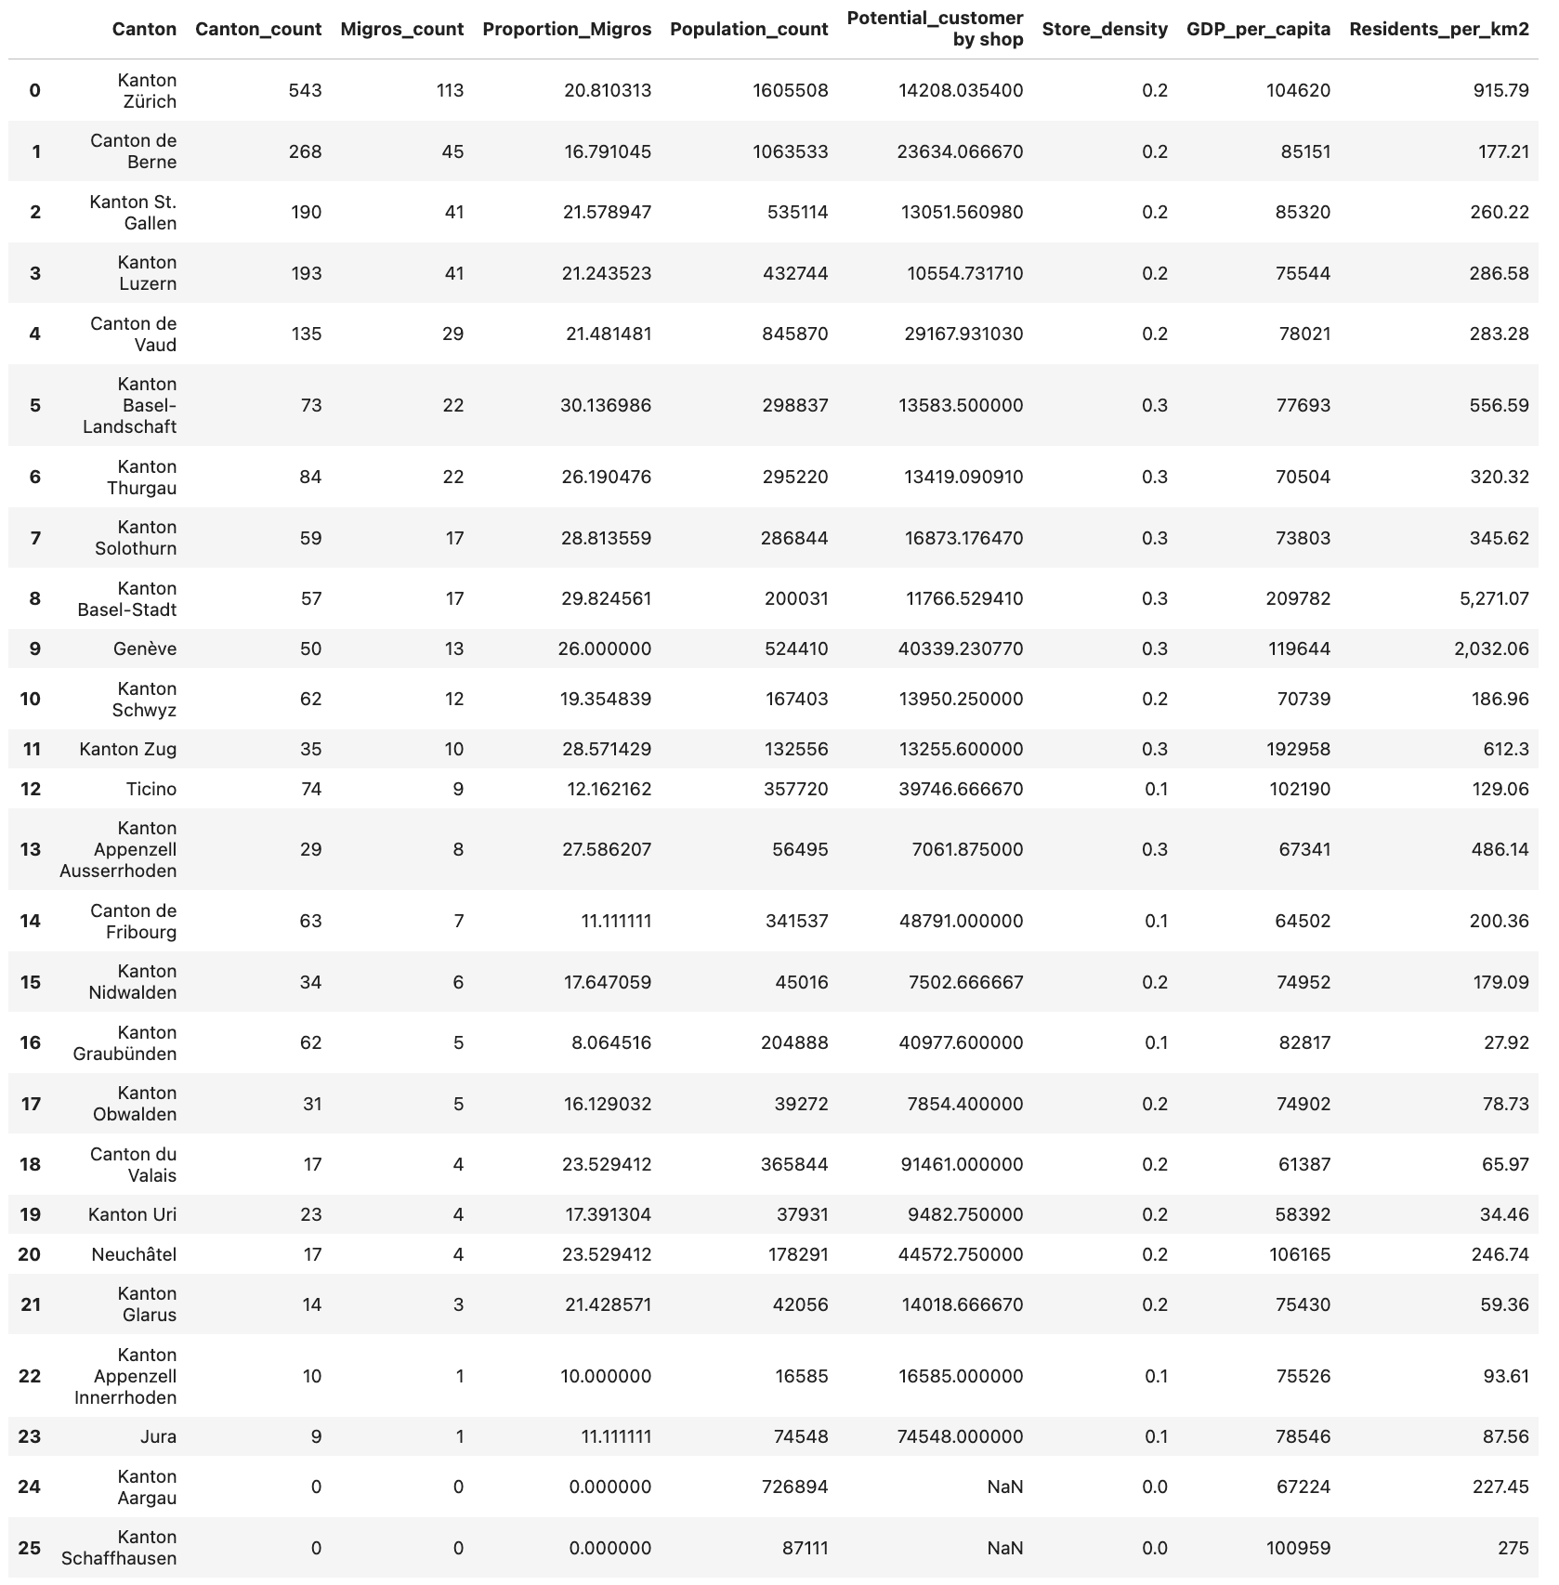
Overview of the gathered data

Slide 4
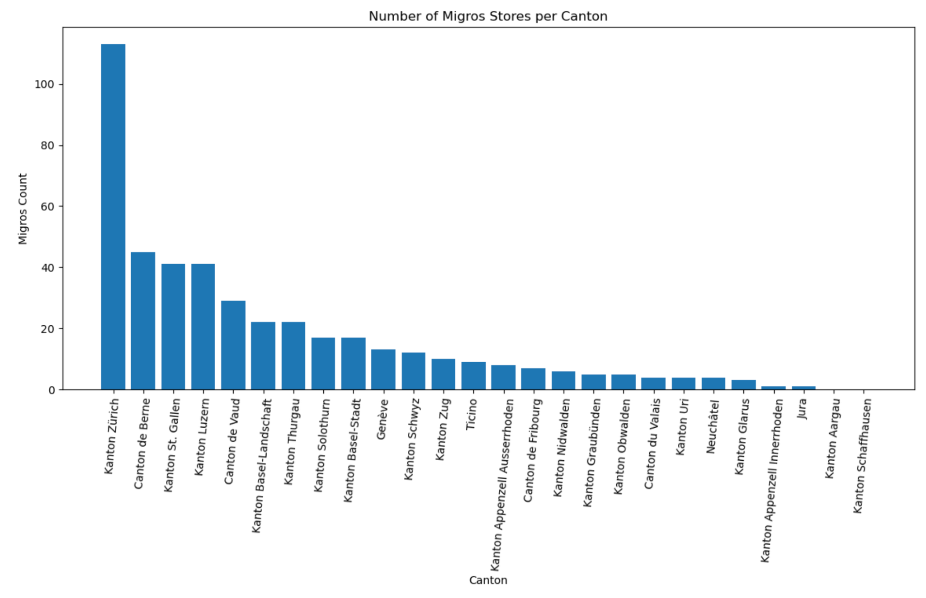
How many Migros stores do we have and where are they located?
Notes:
There are 494 Migros shops in Switzerland,
14 M-Outlets,
and 14 Migros Partners
The biggest competitor for Migros in terms of number or stores in Switzerland are Coop with 463 shops, Volg with 209, Aldi with 166, and Lidl with 146.
For this research, we will focus on the Migros flagship store in comparison with the other flagship stores from the big retailers just mentioned. Because they target to the same type of customers.
(Denner is also associated with Migros since 2007. There are 279 Denner shops, 9 denner partners and 8 denner express shops).
Denner will be treated as a competitor even though Migros got 70 percent of capital actions from Denner SA in 2007, because we want to see where to expand the Migros offer.

Slide 5
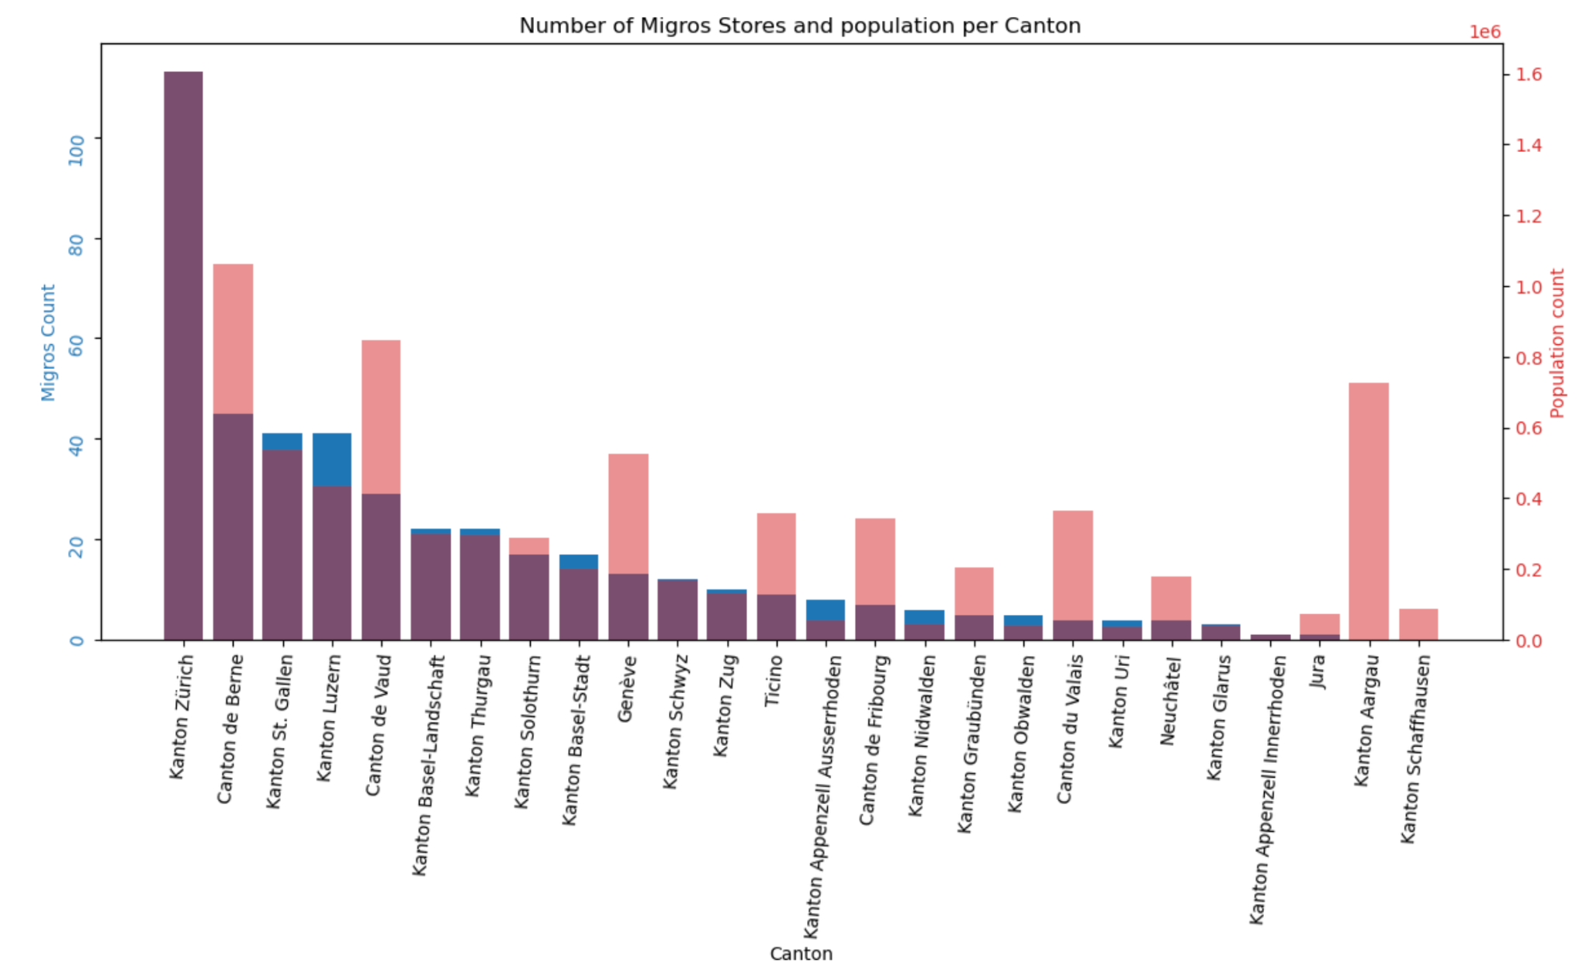
An intuition of potential candidates
Notes:
Here we have some kind of intuition of the proportion of the population Migros covers in each canton. We will have a more precise look later.
Cantons that seem to have more people and not as many stores:
- Valais
- Fribourg
- Ticino
- Jura
- Berne
- Vaud
- Genève
Since we are lacking data for Schaffausen and Aargau I will take them out from now on. There was an issue when retrieving them, maybe they had a different format that was not spotted.

Slide 6
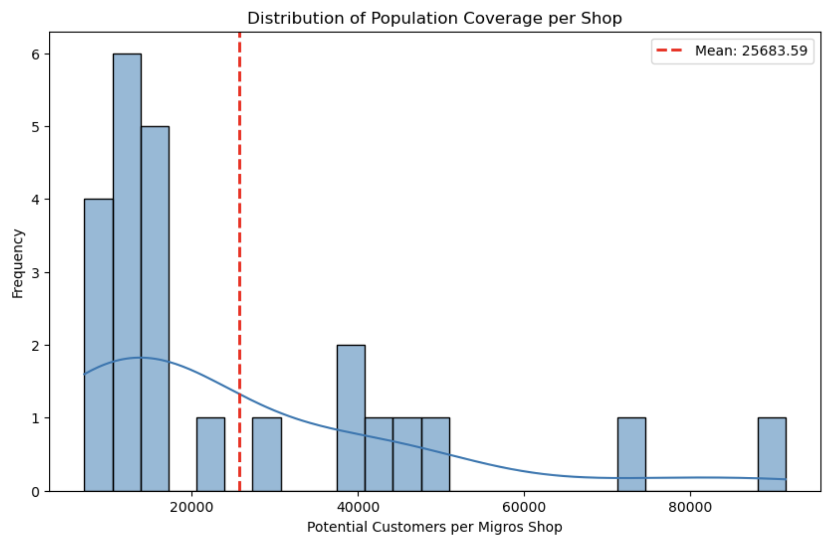
What is the customer population Migros aims to cover on an average?
Notes:
Above we see the mean value for the number of customer for 1 Migros store.
Paired with the Kernel Density Estimate, we see that the data is right skewed so if the current Migros stores are doing well, there is quite some potential for more Migros stores. (we want more frequency on the right side).
While a lot of stores cover less than the mean (frequency on the left), some stores also cover for a lot more. So it would make sense to open new stores and pull the mean to the right.

Slide 7
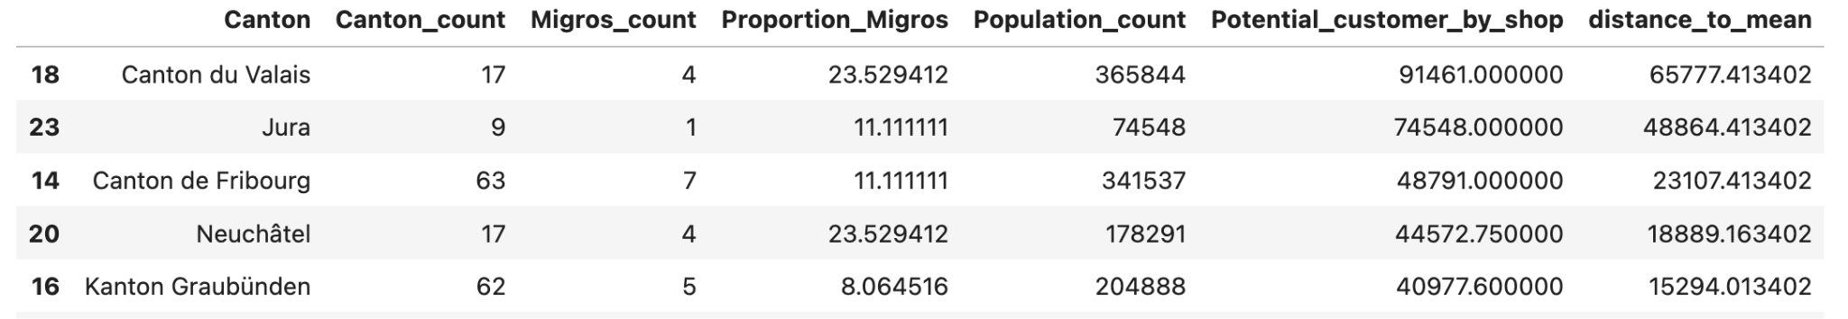
Top 5 candidates in terms of population coverage
Notes:
The top 3 cantons for a new Migros store are :
- Valais
- Jura
- Fribourg

Slide 8
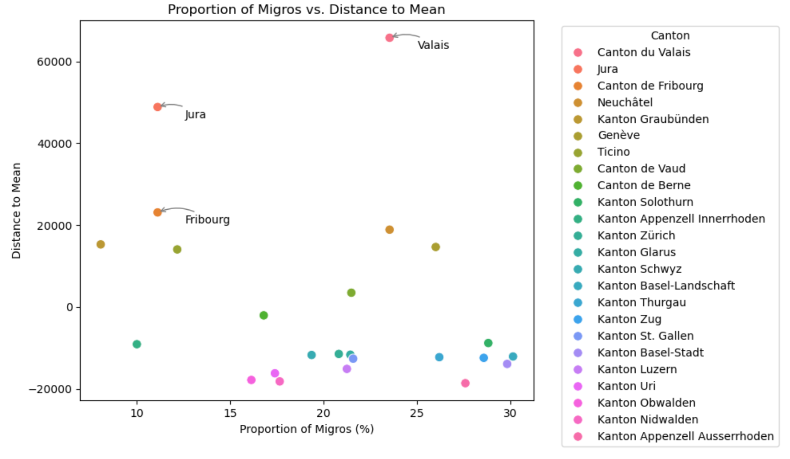
Notes:
The plot above confirms that these cantons have the highest potential for a new shop.
we check how big the concurrence is to see if we could easily make a place for Migros at this location.
We want to see where :
the distance to the mean population coverage is the biggest
while the proportion of Migros compared to other competitors is the lowest because more Migros doesn’t necessarily mean people will come. If we aim at places where there are less Migros, this will bring a different offer and bring people in.

Slide 9
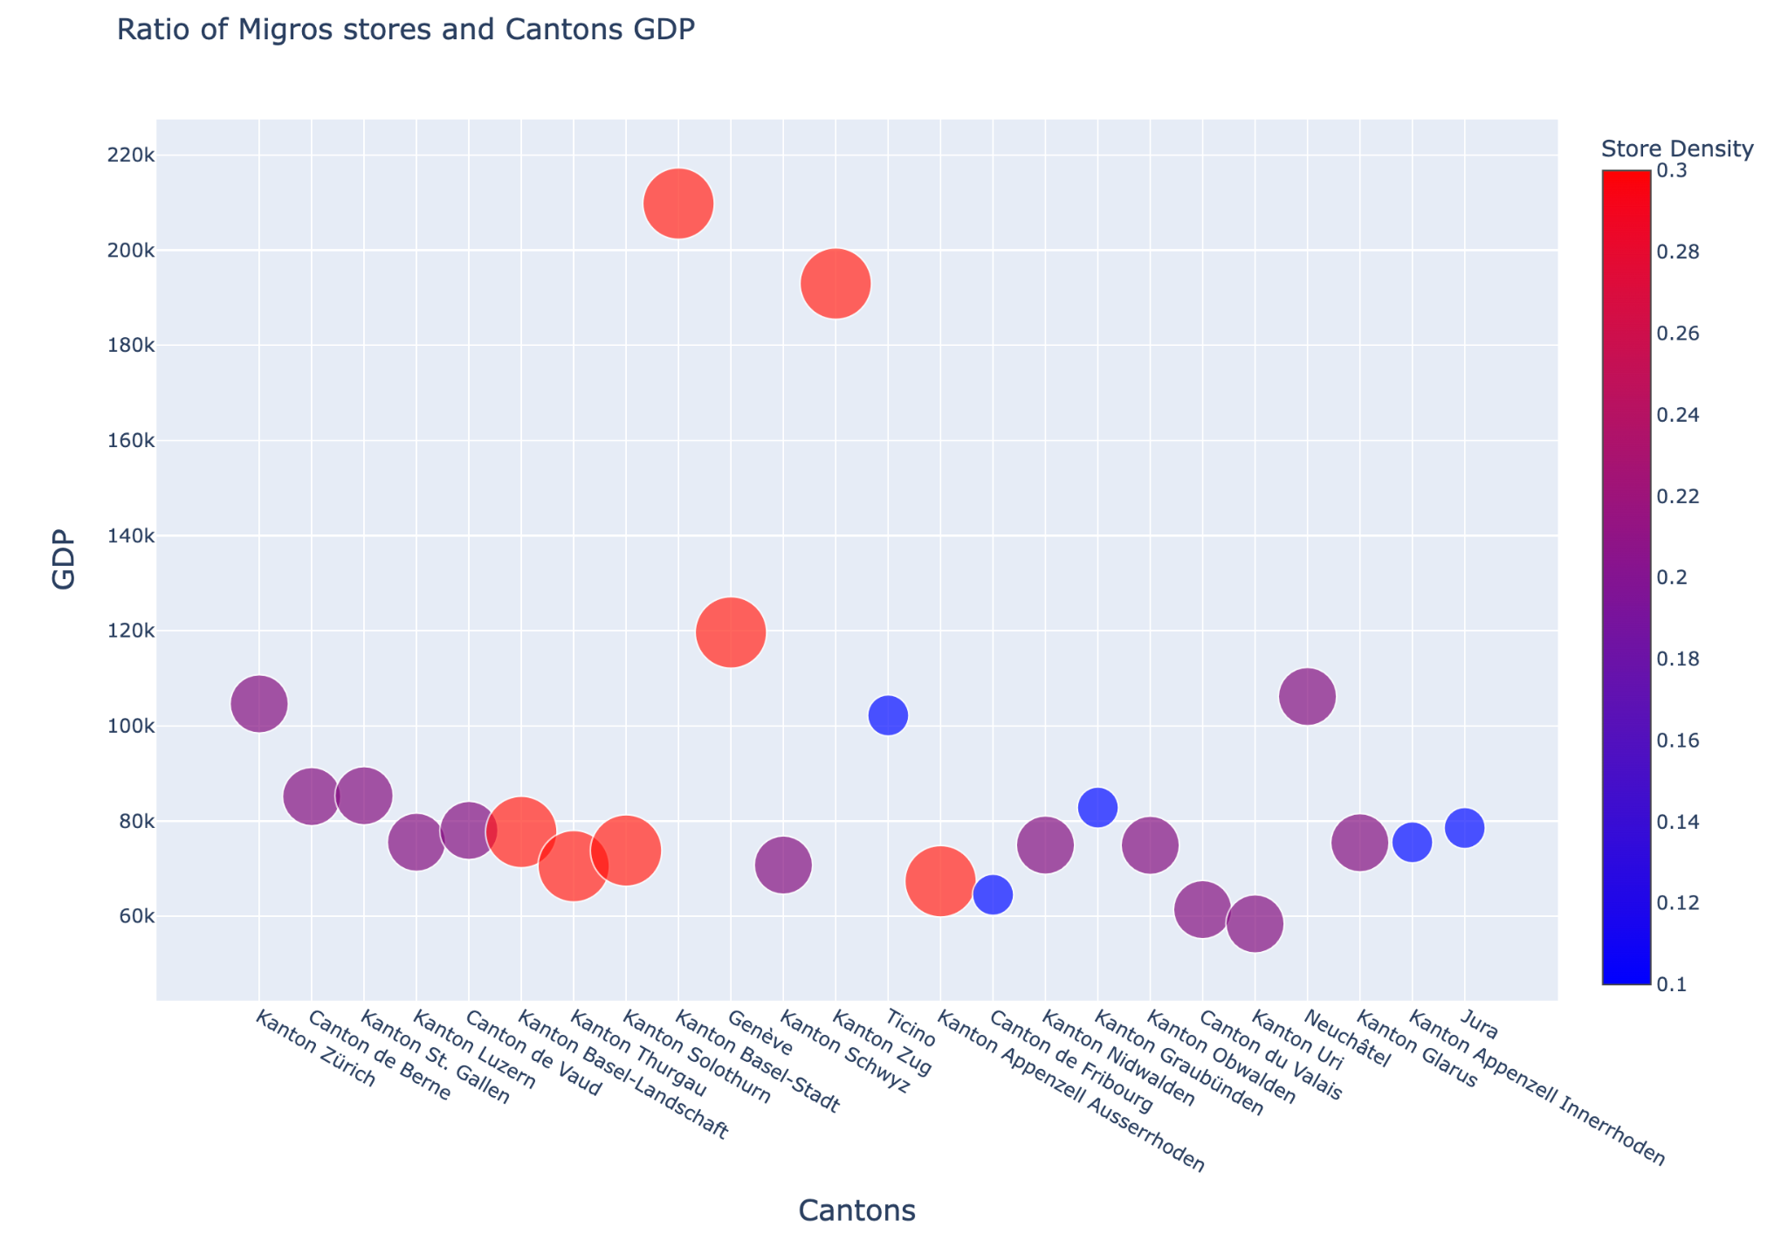
Where do people have money?
Notes:
Cantons with the highest GDP are already well exploited.
If we look at the rest of them, Ticino may be a strategic place to place more Migros when looking at the population revenues
Where are our top 3?
Valais doesn’t earn as much as other cantons and as already a good proportion of Migros, so maybe even if Migros opens a flagship store there it won’t generate as much revenue as wanted. An option would then to rather open an outlet or a Denner with lower prices.
Jura is a better candidate than Fribourg it terms of GDP

Slide 10
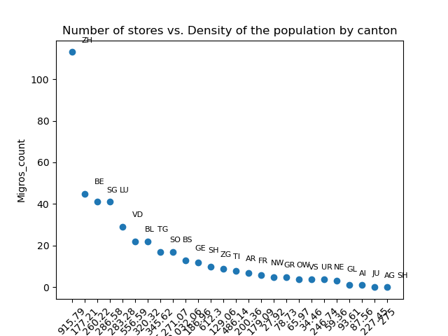
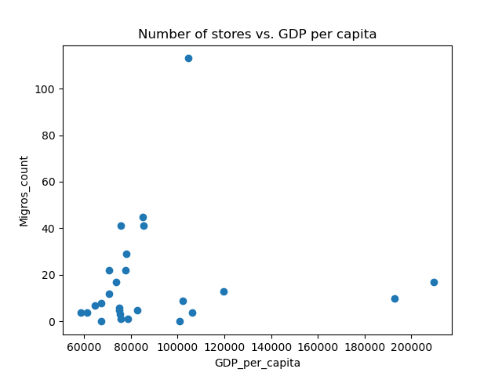
Correlations
Higher GDP per capita → More Stores?
Higher density → More Stores?
Notes:
There is a strong positive correlation between population density and the number of stores. Denser areas (cities) have more stores due to higher demand and easier access. Rural areas have fewer stores due to low population density and larger travel distances between stores.

Slide 11
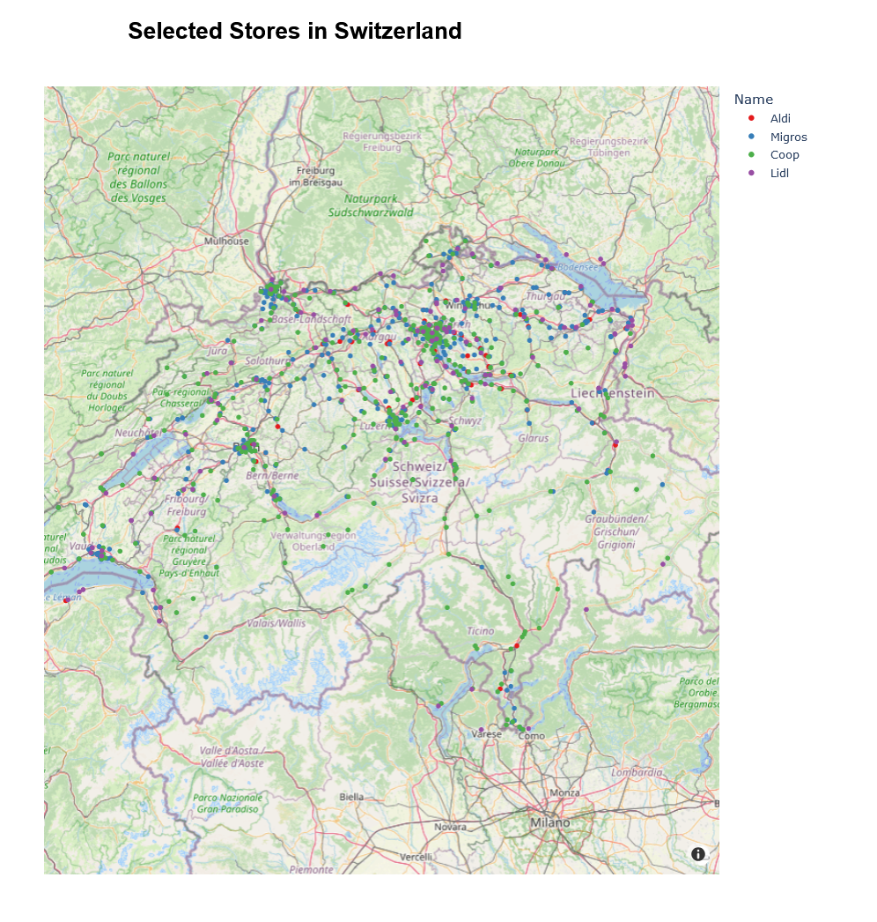
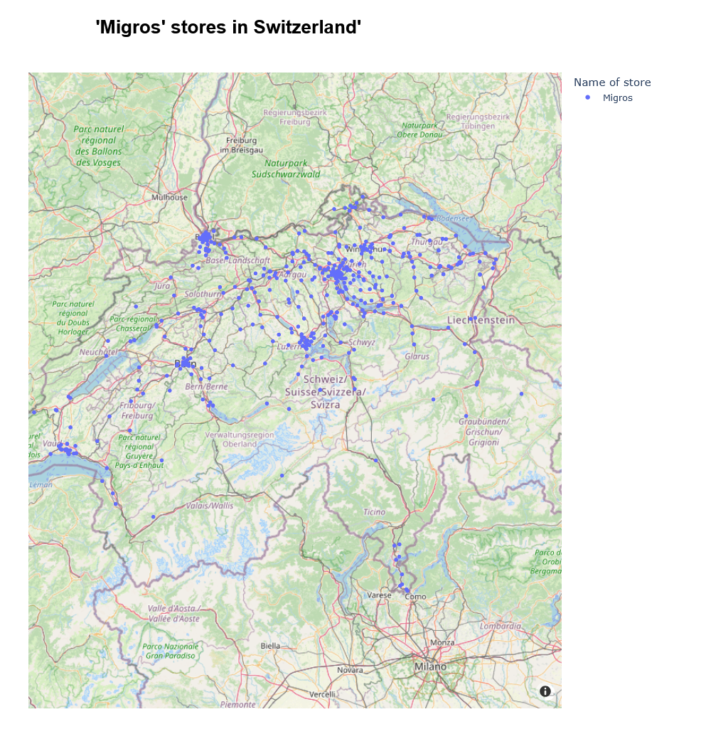
Areas with density of stores
Notes:
here we can see where Migros, Coop, Aldi, Lidl, and other selected stores are located.
the bunch of points indicate areas with a high density of stores, likely in urban centers (e.g., Zurich, Geneva, Bern).
Sparse areas suggest regions with fewer stores, likely in rural or mountainous areas.

Slide 12
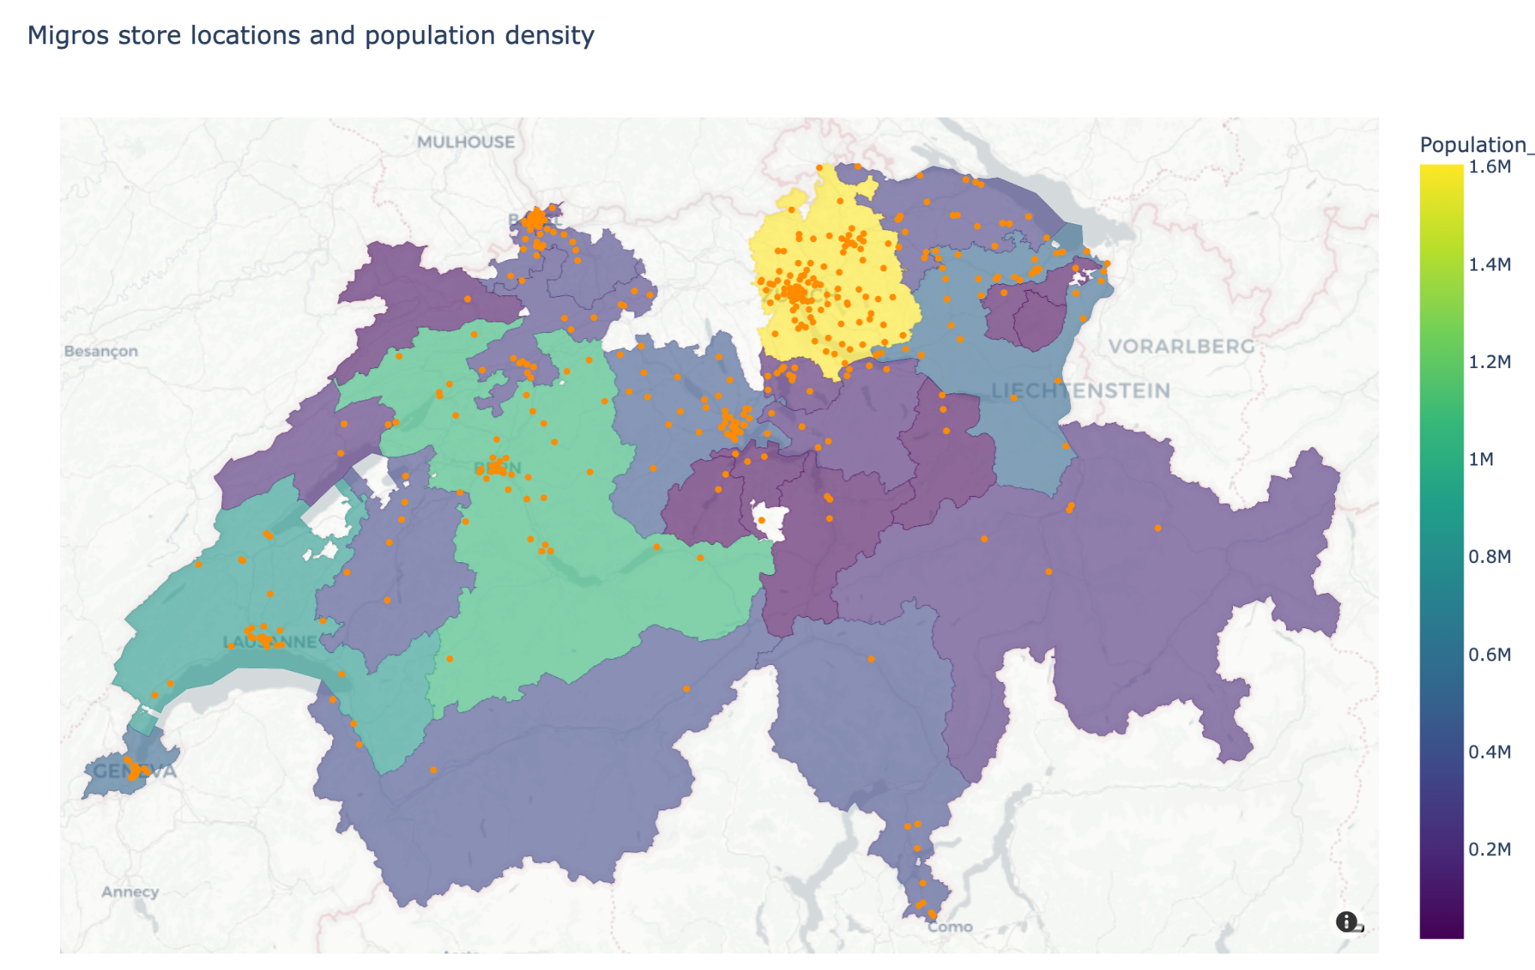
Jura
Fribourg
Valais
Ticino
Notes:
Zooming in on the map you can see some areas that are more or less dense and where the current stores are located.
We need to account for the mountains that do not show on this map, but it still gives a good intuition of where the population is and where a new Migros shop could be located.
The point indicate Migros stores are located only in the main cities of those cantons.

Slide 13
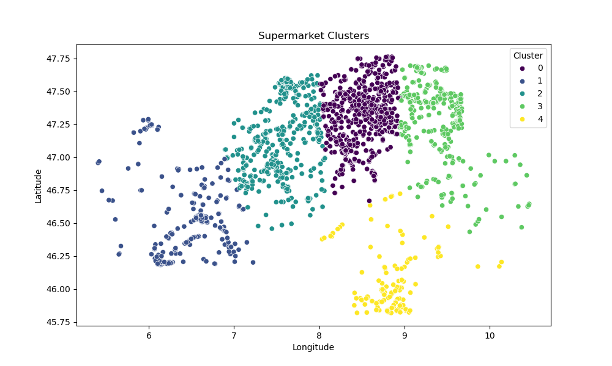
Distribution of 5 nodes of stores in Switzerland
Notes:
how stores are grouped based on their locations and see which areas have more stores close together.
In the future research, an interesting case study would be the analysis of the Correlation of the supermarket locations with population density

Slide 14
Conclusions
Getting more customers:
Jura
Haute-Sorne (est. 7360), Porrentruy (est. 6600)
Fribourg
Gibloux (est. pop. 8130)
Tafers (est. pop. 7900)
Getting customers with money:
Ticino
Capriasca (est. pop. 6760)
Recommendations for Migros’ development strategy

Slide 15
Data source:
Geographical data:
https://www.openstreetmap.org/ (29.01.2025)
Swiss Population:
https://www.citypopulation.de/en/switzerland/f (31.01.2025)
Swiss cantons GDP:
https://www.bfs.admin.ch/bfs/en/home.html

